Slide 1

Fiber composite
geopolymers using Mt. Etna volcanic ash as precursor
Zafarana S.E^{.*1,} Mazzoleni P^{.1,} Occhipinti R.¹
¹Department of Biological, Geological and Environmental Sciences. University of Catania, Italy
*Corresponding author: sabrinazafarana3@gmail.com
Catania, 24-25 February 2022

Slide 2
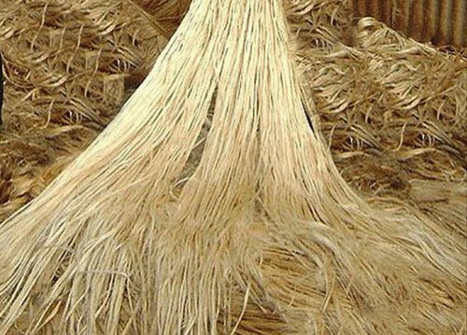
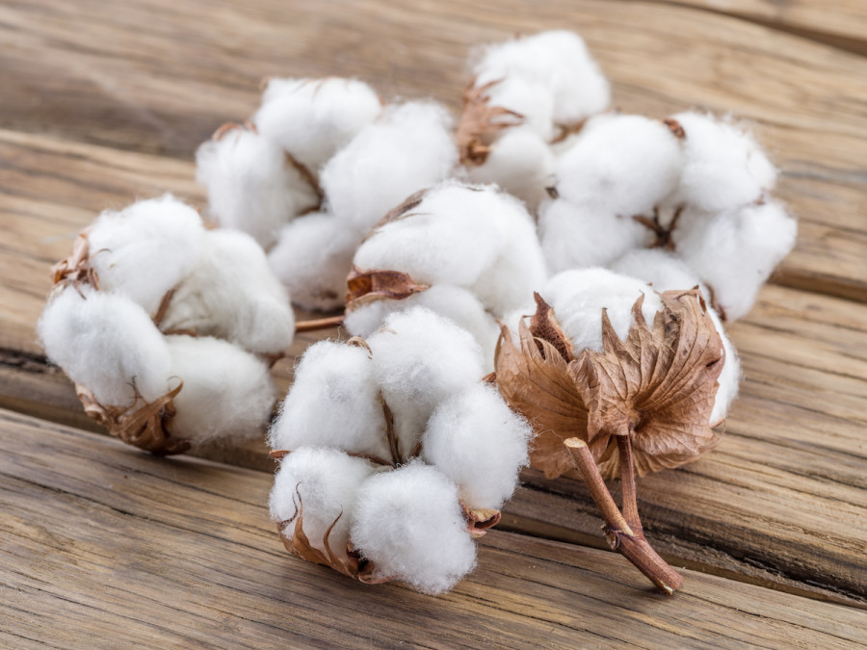
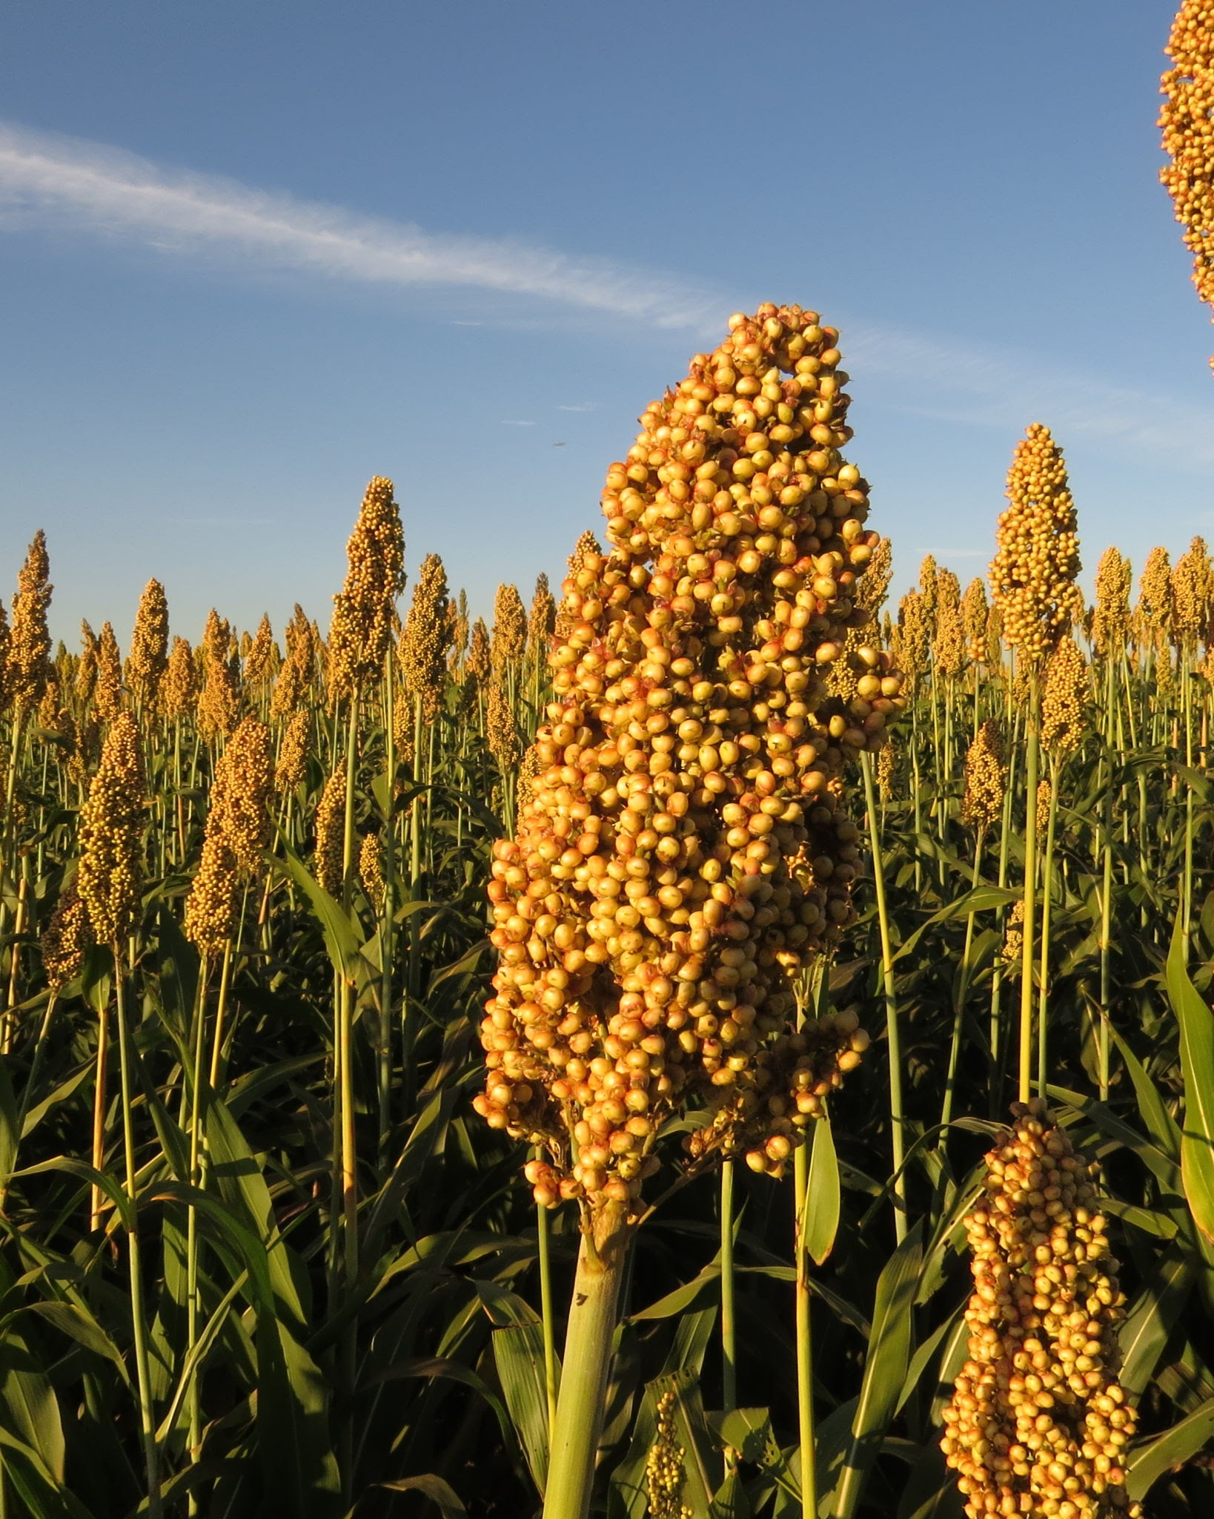
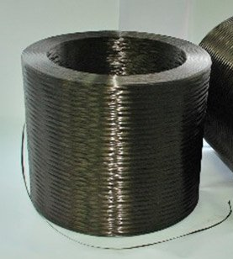
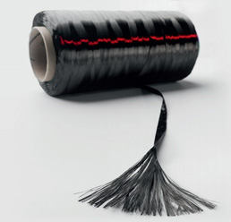
Introduction
Fiber reinforced composite geopolymers
Organic fibers
Synthetic fibers
Jute
Cotton
Sorghum
Basalt
Carbon
Aloyamari et al. 2014, “Synthesis and mechanical properties of cotton fabric reinforced geopolymer composites”. Elsevier Part B, 60, 36-42.
Chen et al. 2014, “Utilization of sweet sorghum fiber to reinforce fly ash-based geopolymer”. J Mater Sci 49, 2548–2558.
Kornijenko et al. 2016, “Mechanical properties of geopolymer composites reinforced with natural fibers“. Procedia Engineering 151, 388 – 393
Alcaide et al. 2007, “Carbon fibre-reinforced, alkali-activated slag mortars”. Materiales de Construcción 57, 288, 33-48.
Ronald et al. 2016, “A study on flexural behaviour of basalt fiber reinforced geopolymer concrete”. IRJET 03 (08).

Slide 3
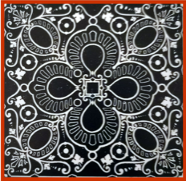
Introduction
AGM for CuHe, supported by the AGM for CuHe project (PNR fund), Materiali di nuova generazione per il restauro dei Beni Culturali: nuovo approccio alla fruizione. CUP E66C18000380005.
This study was carried out within the project “Advanced Green Materials for Cultural Heritage” (AGM for CuHe) at the University of Catania.
Creating new materials for structural reinforcement in seismic zones.
Analysing the structure and the mechanical properties of fiber reinforced geopolymer made using Mt. Etna volcanic ash as precursor and adding organic local prickly pear fibers.

Slide 4
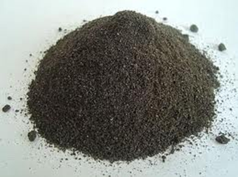
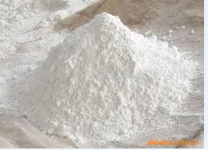
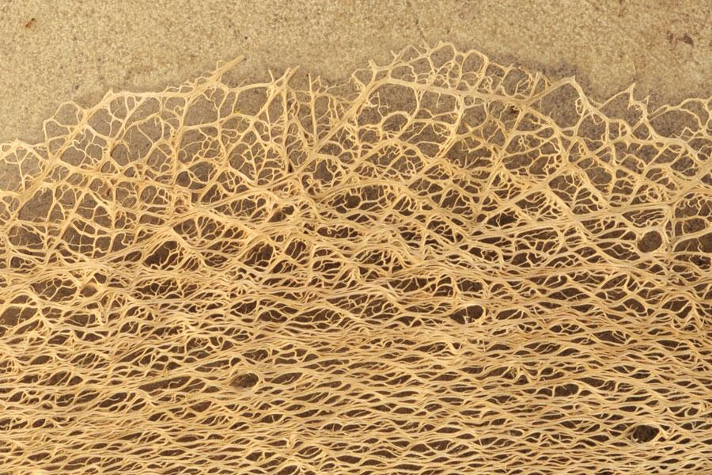
Materials
Binders (from Barone et al. 2020):
Volcanic ash from Mount Etna
Metakaolin
Activating solution (sodium silicate and sodium hydroxide)
Fiber reinforced geopolymer:
Binders
Organic fibers

Slide 5



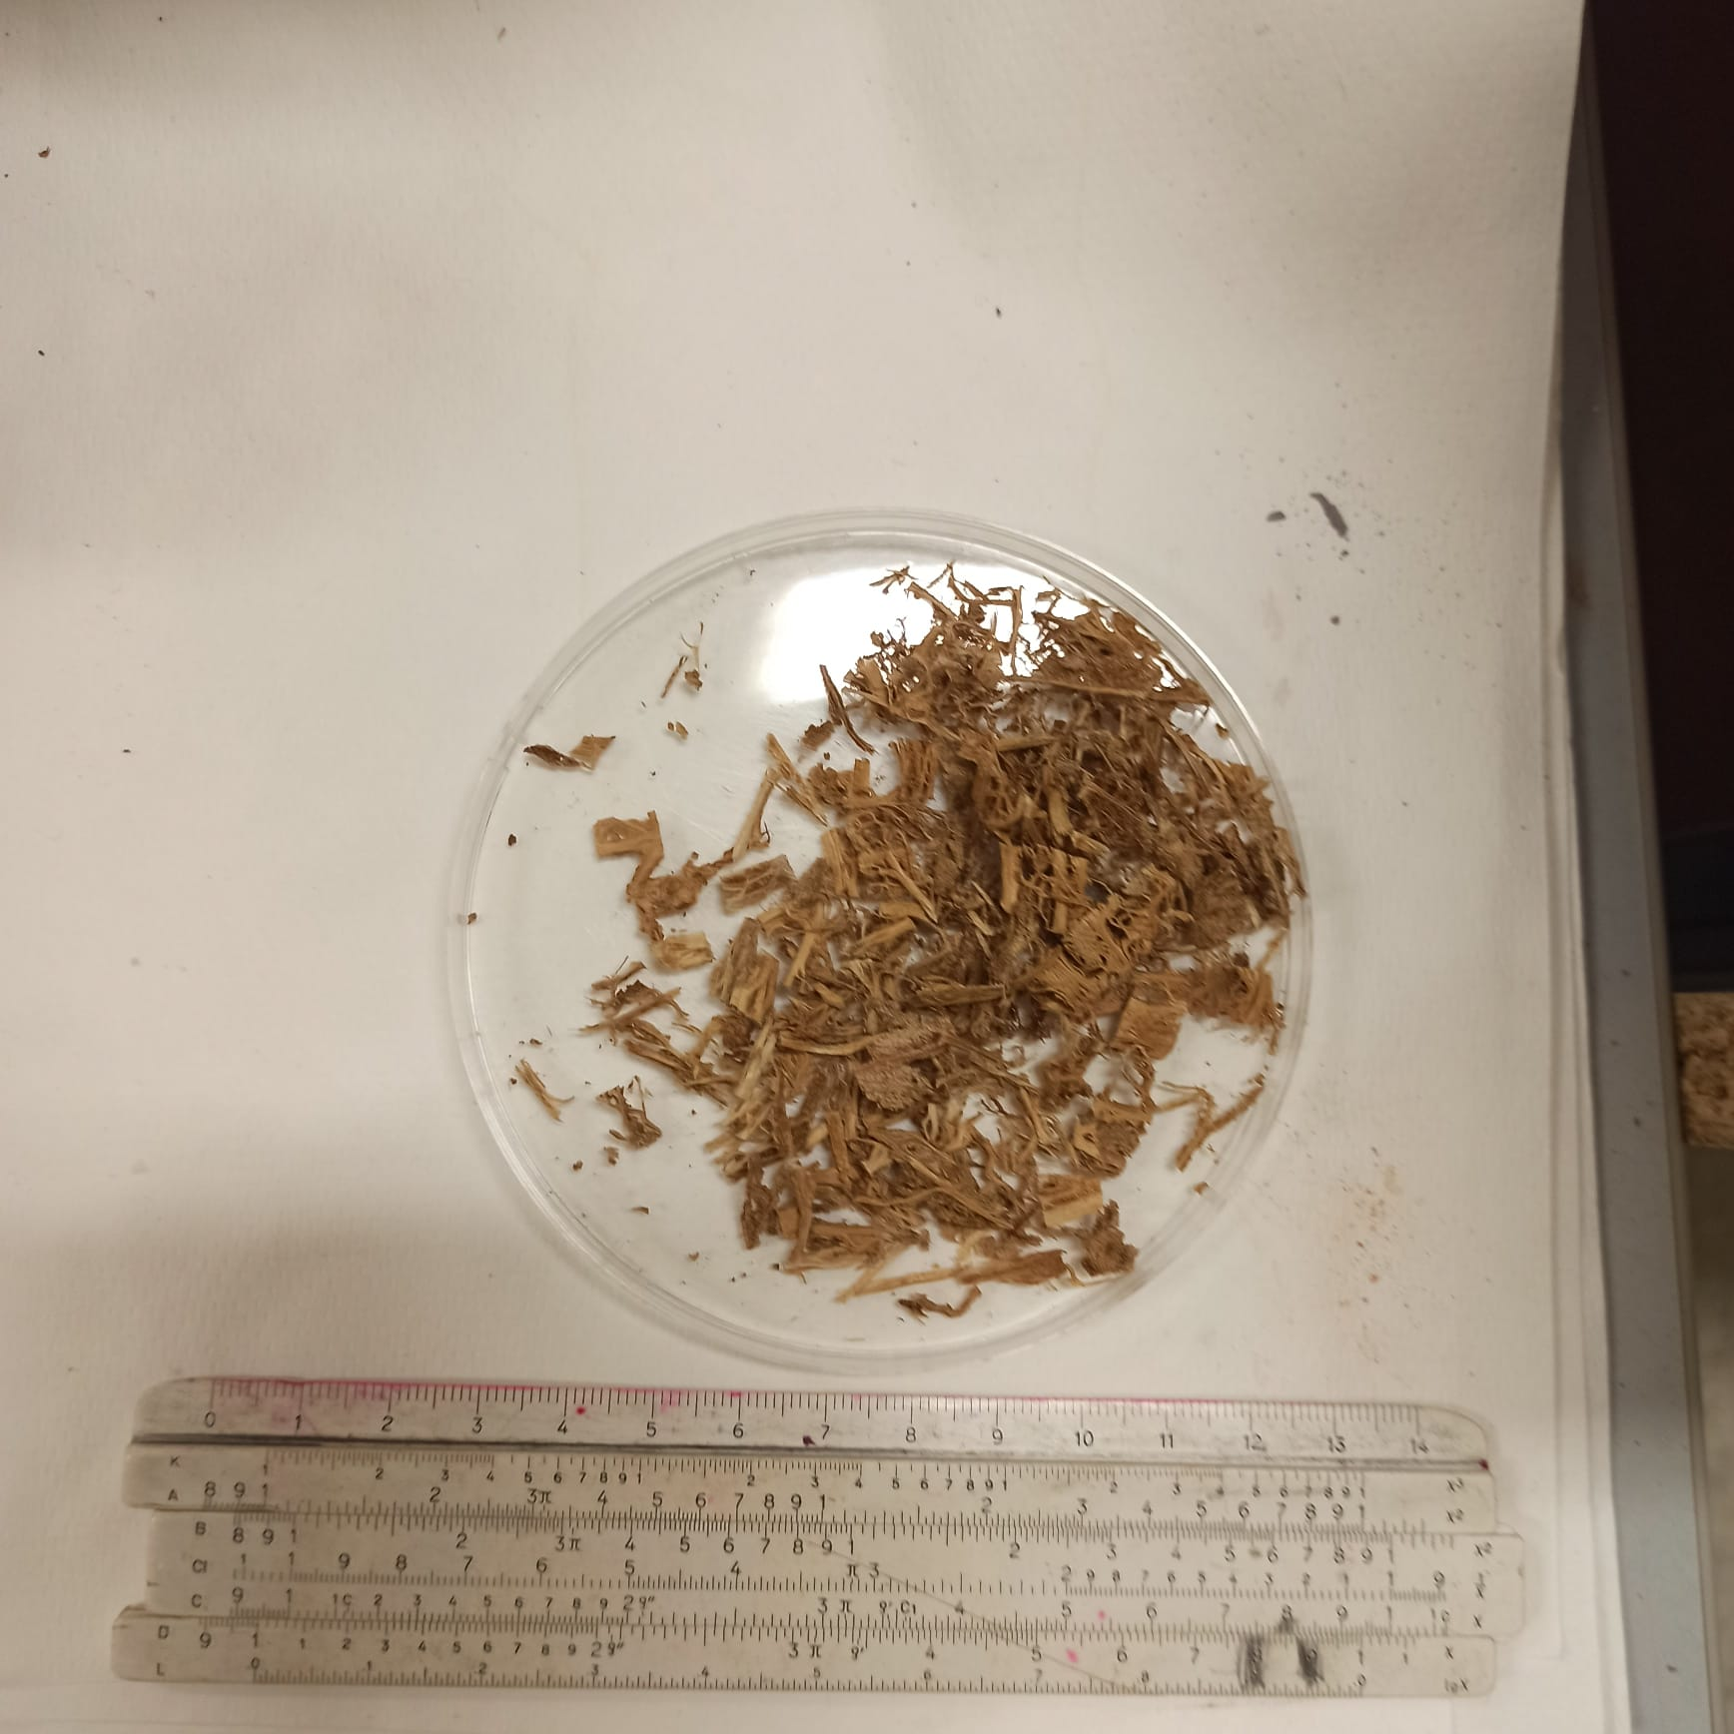
Preparation of the fibers
Selection of prickly pear fibers. According to literature 1wt.% fibers were cut in two different lengths and then dispersed into the matrix.

Slide 6
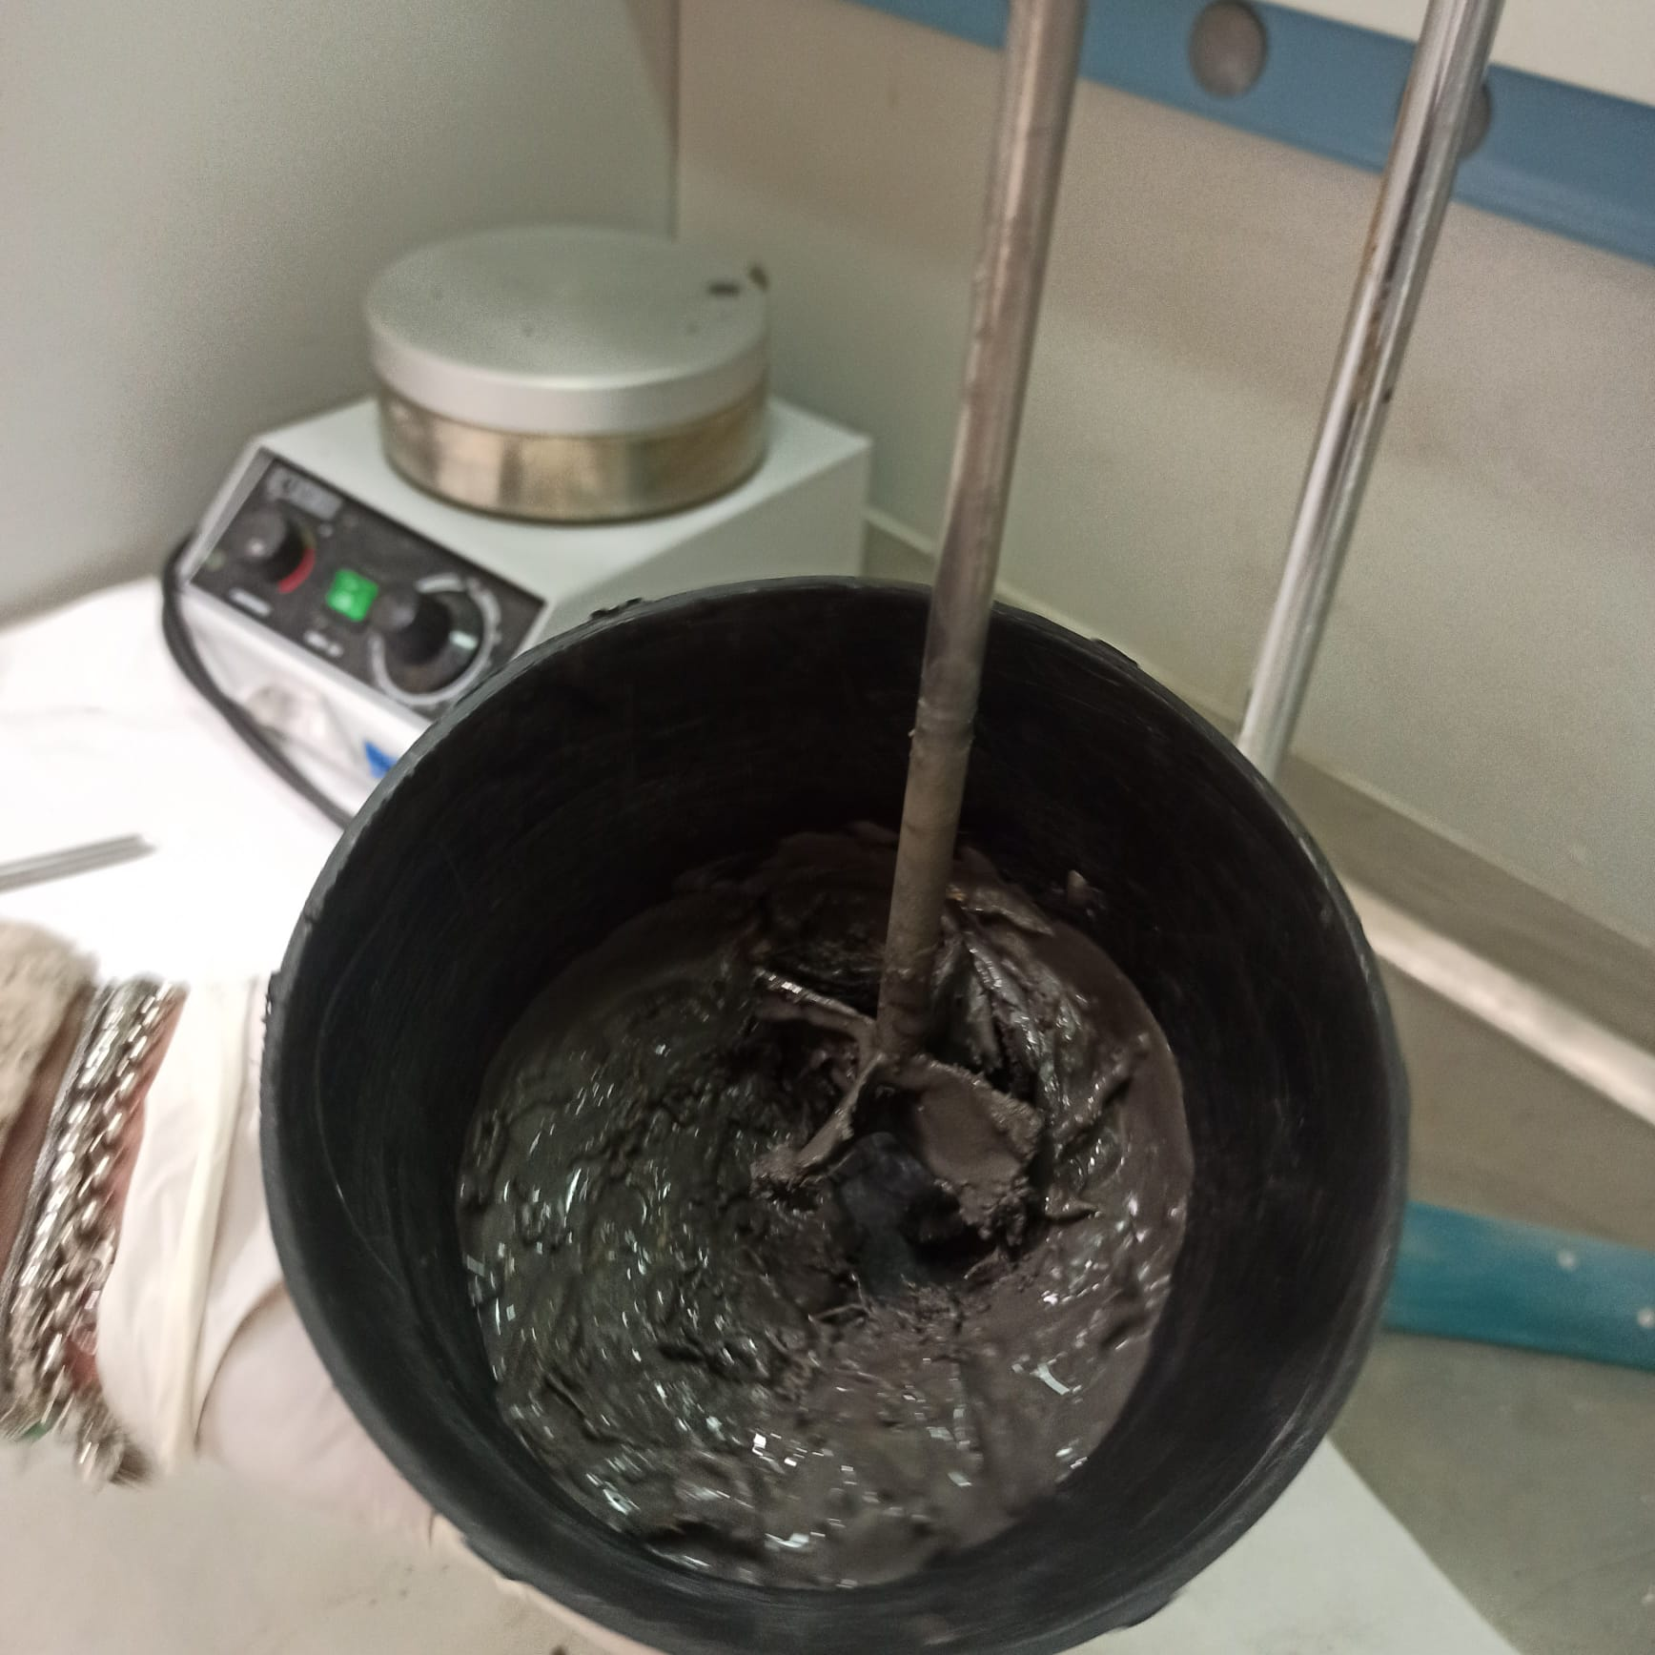
Synthesis
Mixing of precursors and solution
Addition of the organic fibers to the paste after reducing the mixing velocity

Slide 7
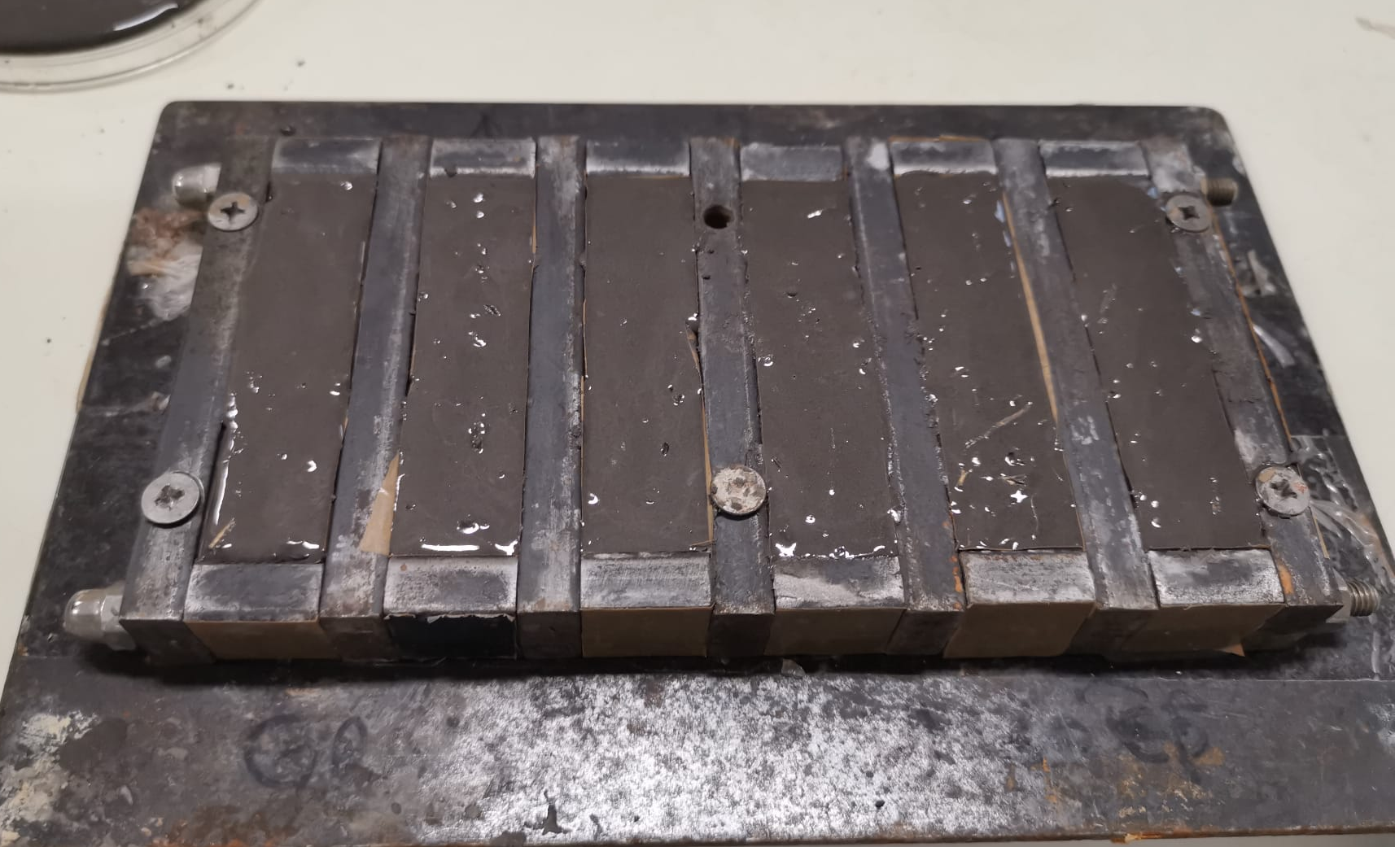
Curing stage
Pouring of the geopolymeric paste into moldes
Curing for 28 days at room temperature

Slide 8
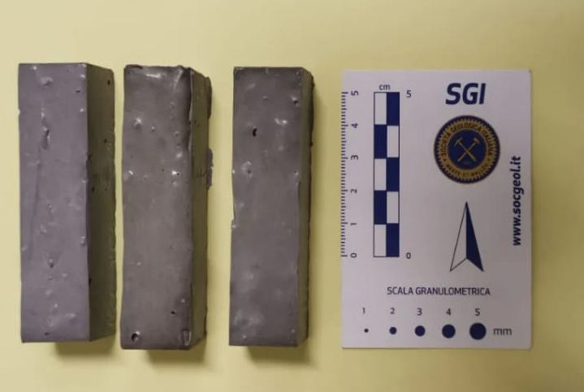
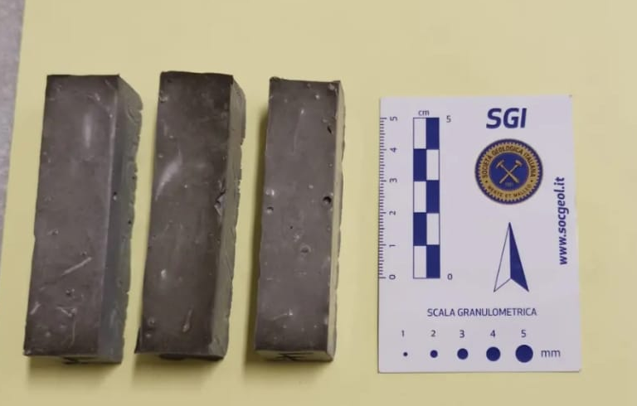
Samples after curing stage
Samples with short and thick fibers were named as G1- G2- G3.
Samples with long and thin fibers were named as F1- F2- F3.

Slide 9
Preliminary testing methods
The samples were analysed testing:
Flexural strength;
Morphological features of the matrix (SEM- EDS).

Slide 10
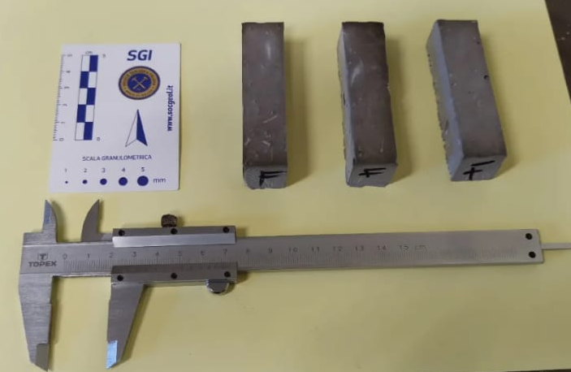
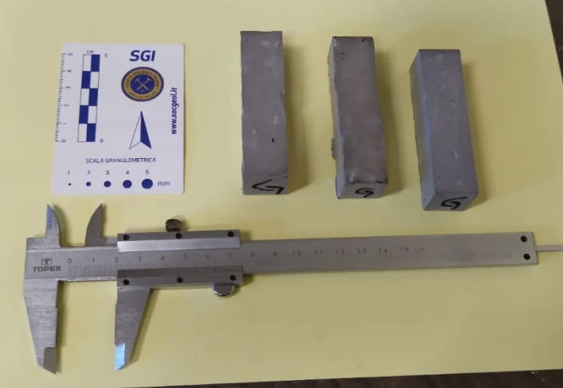
Testing methods
In order to compute the area, base and the height was measured in two directions. The mean value was used in calculations.

Slide 11
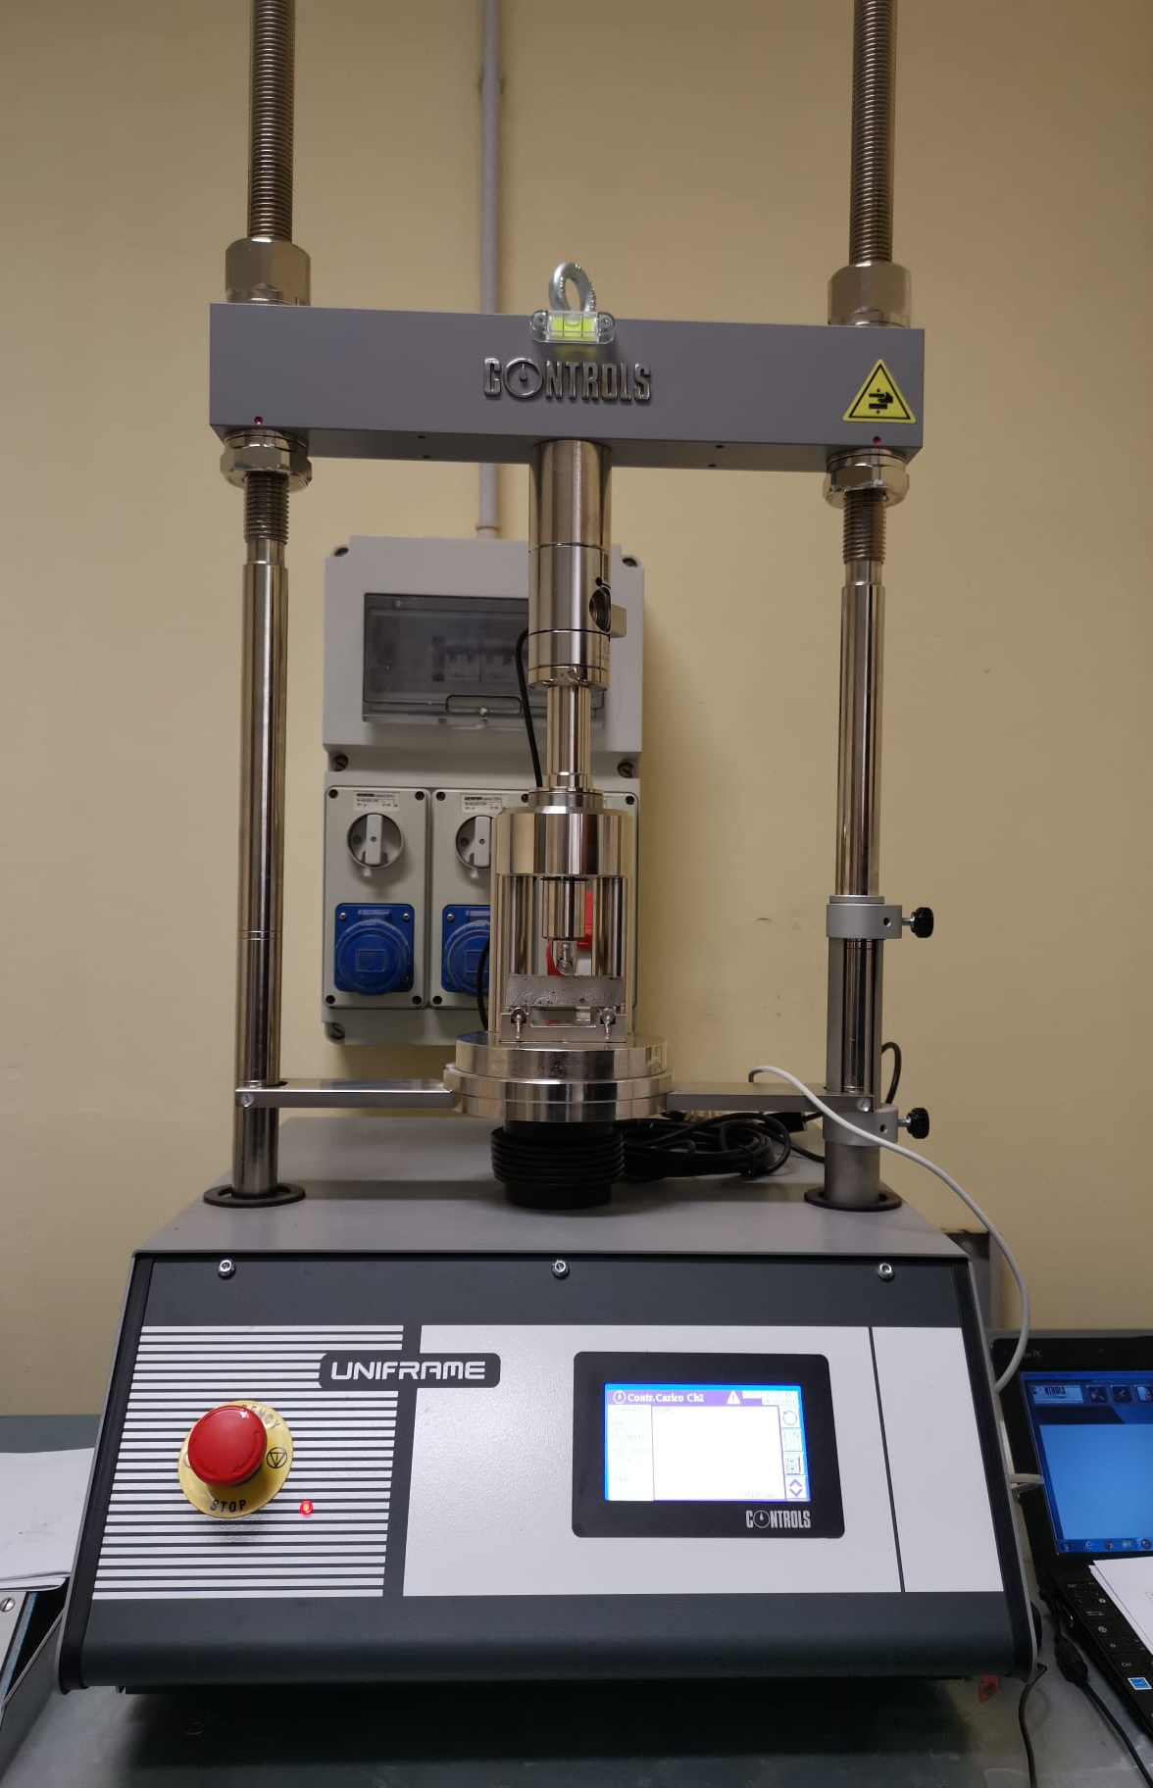
Testing methods
Flexural strength was tested in order to compare the mechanical properties of geopolymer composites both with and without fibers

Slide 12
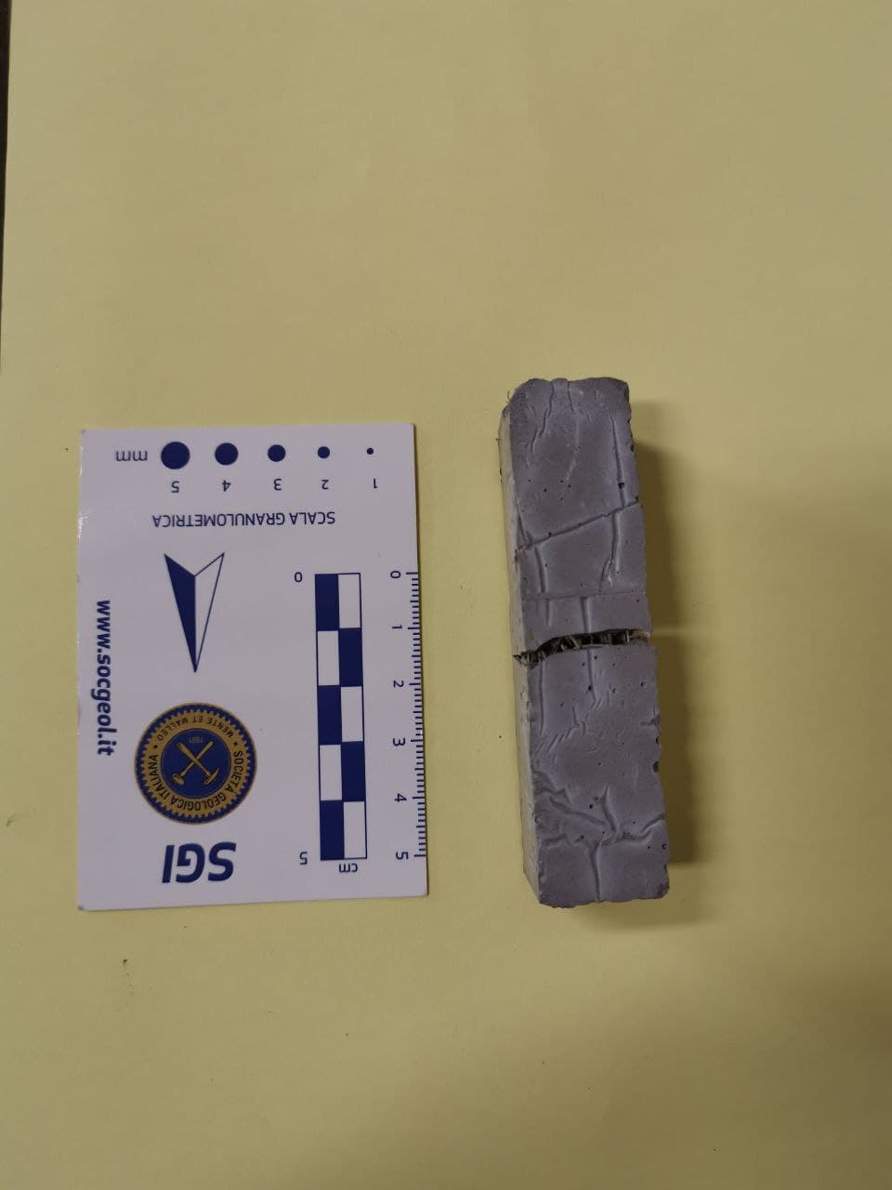
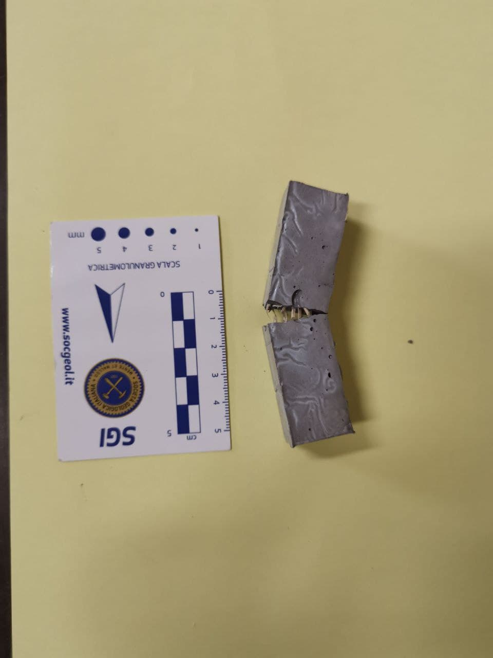
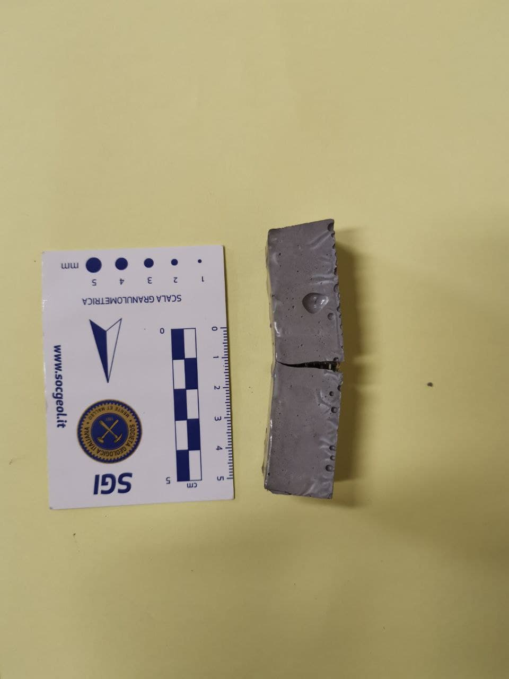
Results
Samples F1, F2 and F3 after flexural strength testing.
The two sides of the samples were kept together by the fibers.

Slide 13
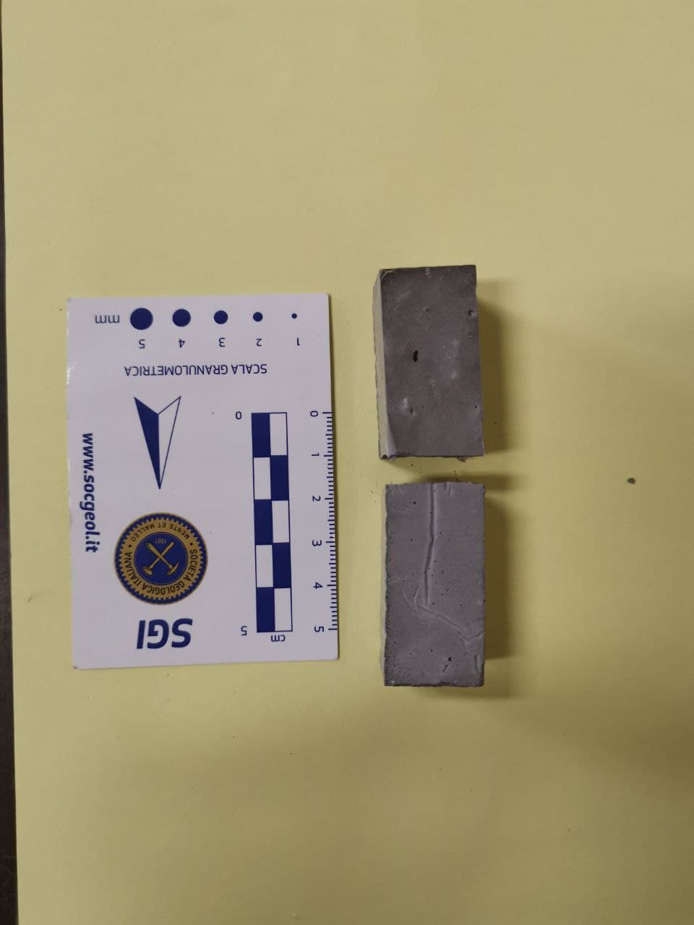
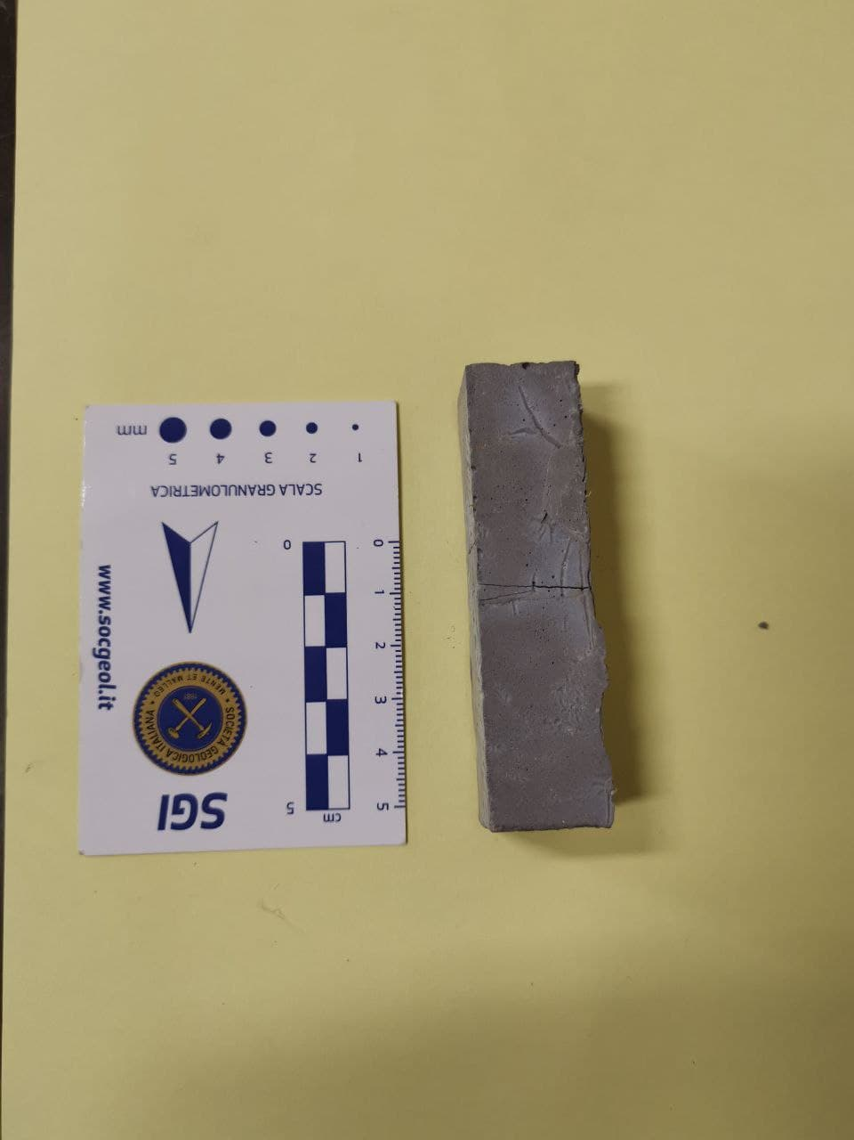
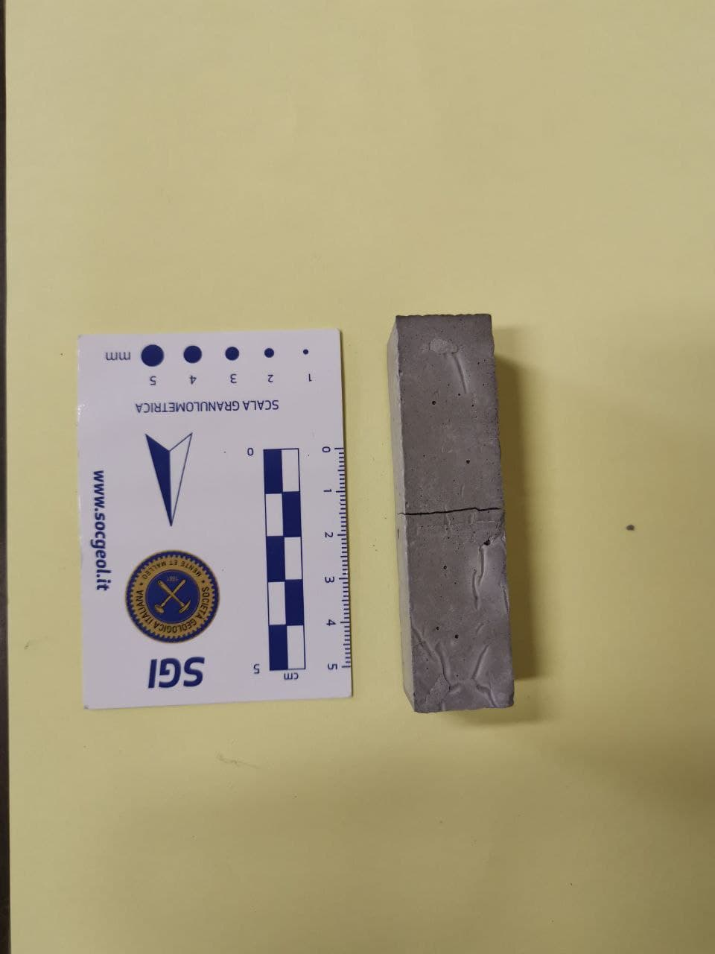
Results
Samples G1, G2 and G3 after flexural strength testing.
Fibers were too short to keep together the sample.

Slide 14
Results and comparison with literature
Sample | MPa | Standard deviation of recorded values of strength
Geopolymer with thick prickly pear fibers (1%) | 5.63 | 0.38
Geopolymer with thin prickly pear fibers (1%) | 5.05 | 0.60
z
Geopolymer (matrix) | 5.55 | 0.72
Geopolymer with coir fibers (1%) | 5.25 | 0.57
Geopolymer with cotton fibers (1%) | 5.85 | 0.78
Geopolymer with raffia fibers (1%) | 3.05 | 0.35
Geopolymer with sisal fibers (1%) | 5.90 | 0.14
Korniejenko et al. «Mechanical properties of geopolymer composites reinforced with natural fibers»

Slide 15
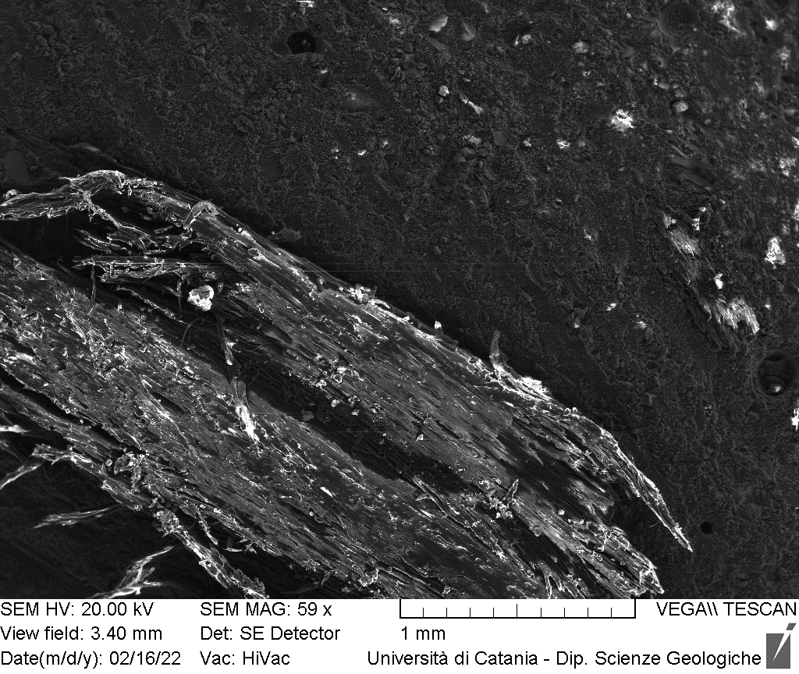
SEM ANALYSIS
Thick fibers

Slide 16
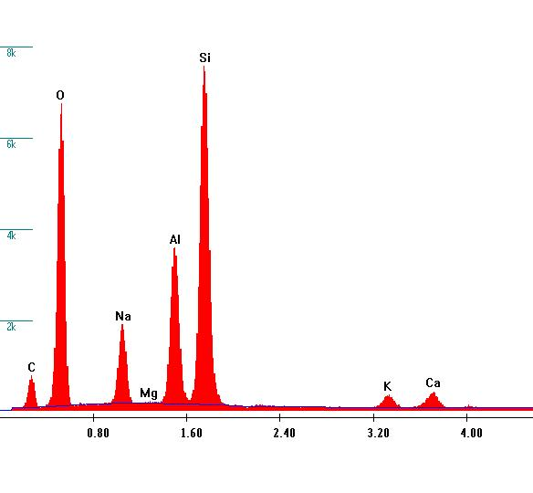
SEM- EDS ANALYSIS
Thick fibers
GEOPOLYMER
Si
O
Al
Na
C
K
Ca

Slide 17
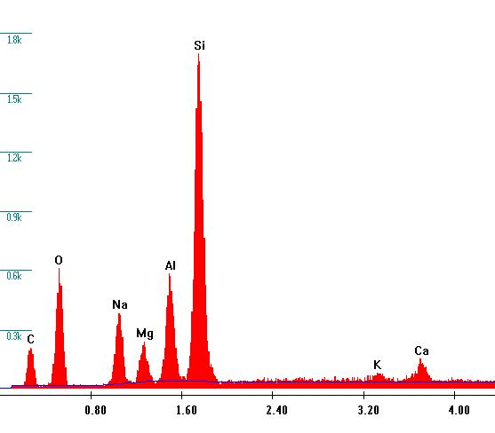
SEM- EDS ANALYSIS
Thick fibers
Si
O
Al
Na
C
Ca
K

Slide 18
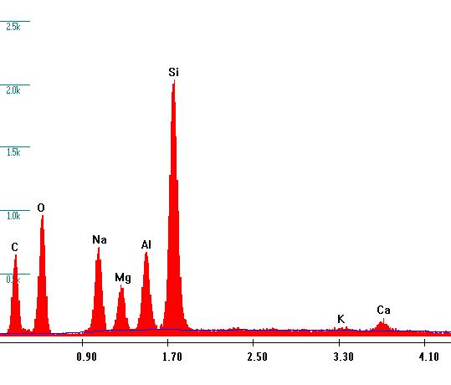
SEM- EDS ANALYSIS
Thick fibers
FIBER
Si
O
C
Na
Al
K
Ca

Slide 19
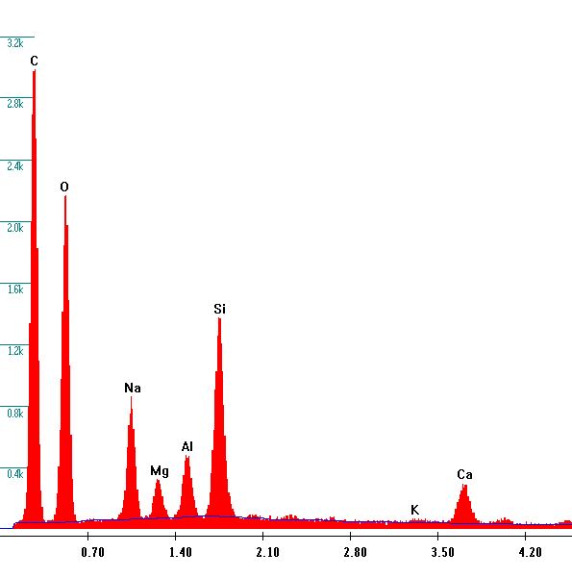
SEM- EDS ANALYSIS
Thick fibers
FIBER
C
O
Si
Na
Al
Ca
K

Slide 20
Conclusion
Samples obtained using short and thick organic fibers (G1, G2, G3) resulted to have higher flexural resistance with a medium value of 5,63 MPa;
Samples obtained using long and thin organic fibers (F1, F2, F3) resulted to have slightly lower flexural resistance with a medium value of 5,05 MPa;
While sample G1 completly break, samples obtained from the addition of thin and long fibers bended, preventing brittle failure;
Preliminary SEM images confirm that the fibers are adherent to the matrix;
Further researches are in progress.

Slide 21
THANK YOU FOR YOUR ATTENTION

